Slide 1


Google Scholar
Carter Matherly, Ph.D.

Slide 2


Content
Introduction
What is GoogleScholar?
The Basics
Citation Management
Advanced Searching
Email Alerts
Adding a Library
GoogleScholar vs. University Databses
Bio

Slide 3


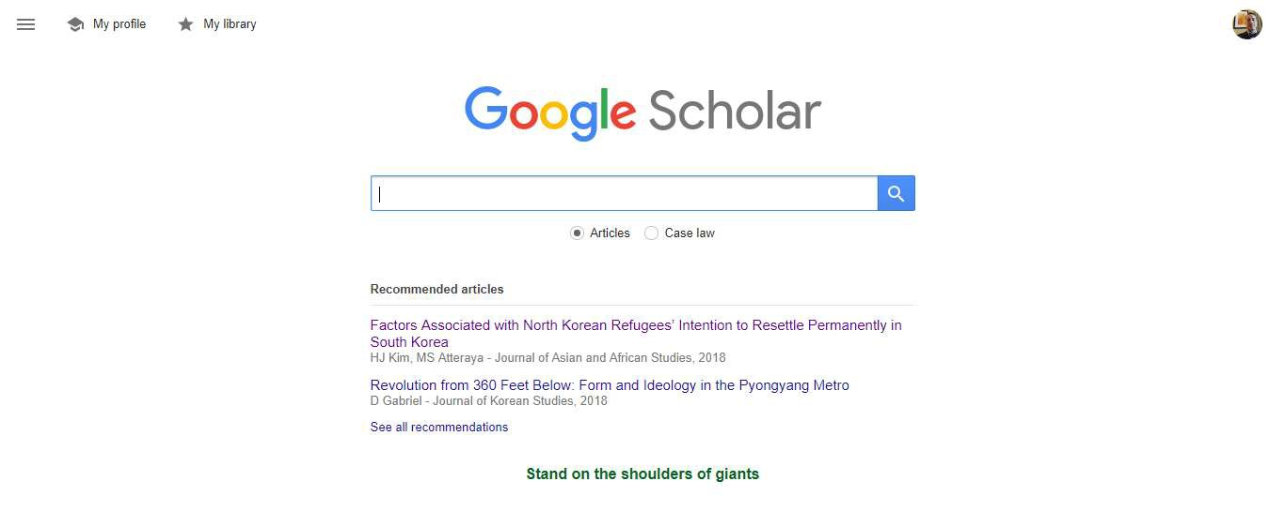
https://Scholar.Google.com
It is just like Google, but for academic articles.
What if Google went to School?
Search it just like Google.
Type in a Topic… like, “Mortality Salience and PTSD”
What is
GoogleScholar.
Hit Enter to search!

Slide 4

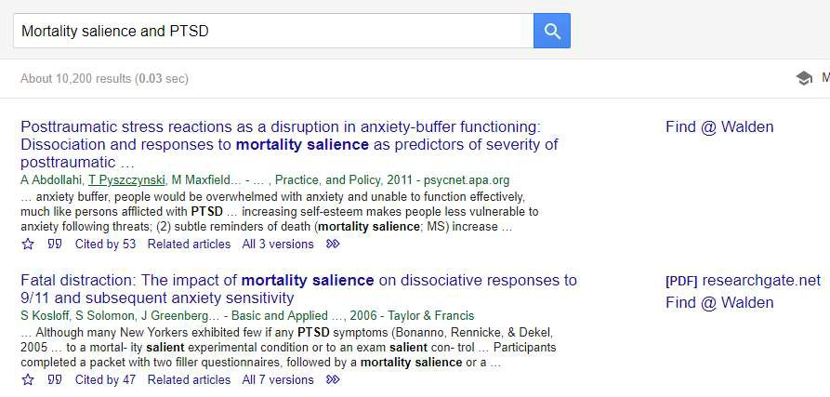
Google has found 10,200 results on that topic!
The Basics.
Lets take a closer look that this information.

Slide 5

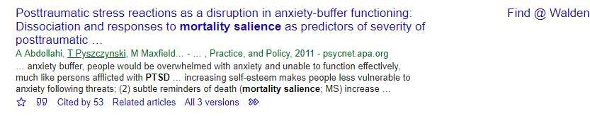
The title is the first thing listed. It is hyperlinked to the article source.
The Basics.
A quick excerpt from the abstract will show up below the title. Key words from your search will be displayed in bold.
The link way off to the right shows databases or libraries you can use to access the article. (How to add libraries is discussed later on.)

Slide 6

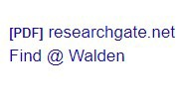
Just below the title Authors, the Journal, publication year and a website will be listed.
The Basics.
These icons are life savers, the next slides will cover them.
Sometimes articles are available though multiple sources. If ‘[PDF]’ is shown that link will take you to the PDF version of the article – for
FREE.

Slide 7




Adds the article to your Profile Library
Cites the Article
Displays who has cited it
Showcases related articles
Will bring up different versions of the same article
The Basics.
PRO Tip: Get comfortable with each of these icons. They will all help you streamline and speed up your research.

Slide 8

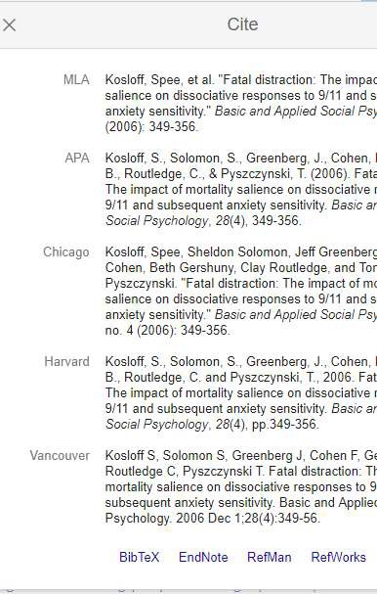
Click on the Quotes to bring up the citation box.
Citation Management.
Simply highlight the format you want, copy and paste it into your document!
You can also export the reference data to several citation management software tools!

Slide 9

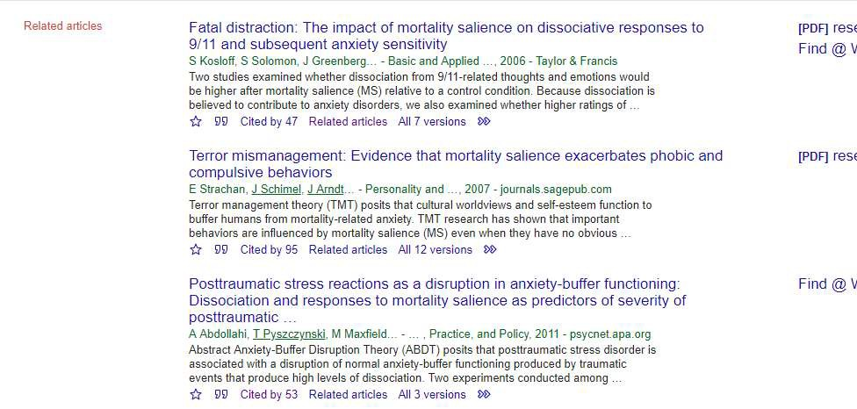

Click on the Related Articles link to see a list of articles related to the one you are looking at.
Advanced Searching.
PRO Tip: Use this feature while working on a literature review to understand how previous research influenced what you just read. It can also help in locating seminal literature.

Slide 10

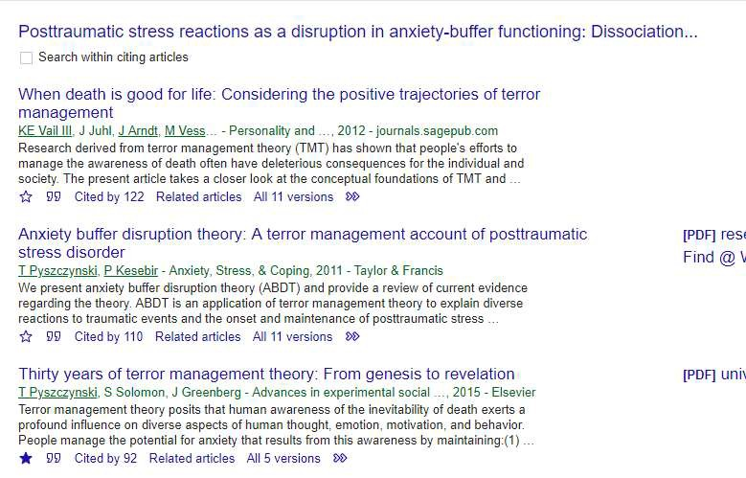

Click on the Cited By link to see a list of articles that referenced this article in future research.
Advanced Searching.
PRO Tip: While writing a literature review This feature will show you how this article influenced future work. It will also identify what others said were limitations of the research.

Slide 11
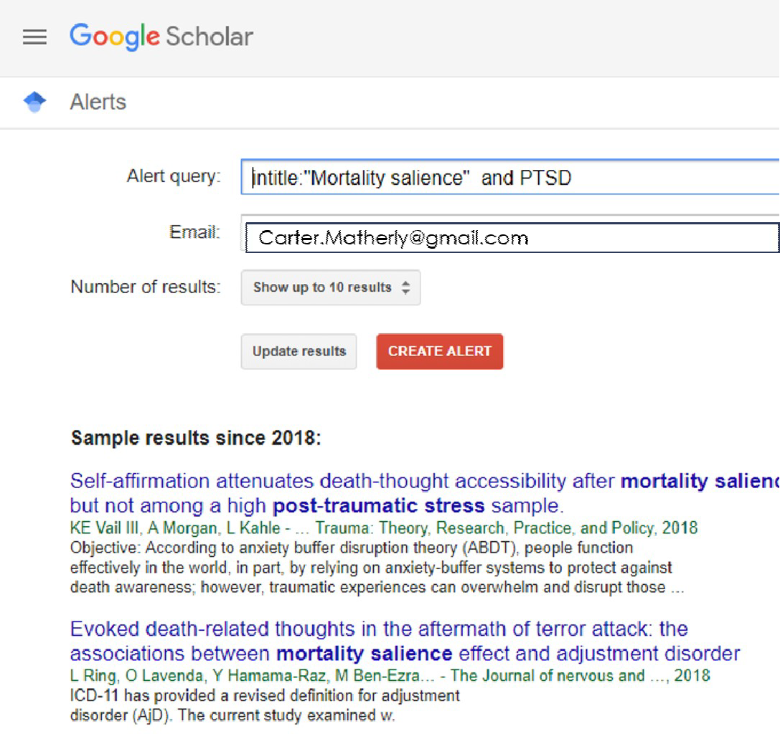
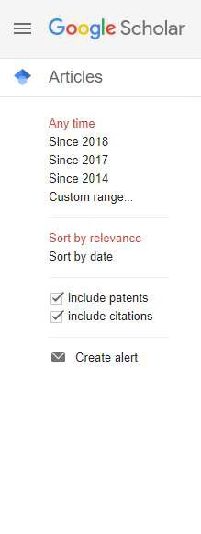

Email Alerts.
PRO Tip: This feature is perfect for keeping up to date on a topic of interest. This will help prevent your literature review from falling behind as research advances.

Slide 12


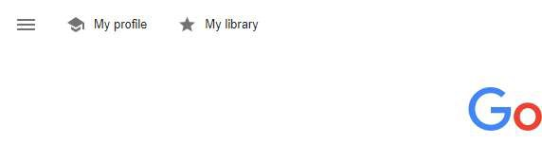
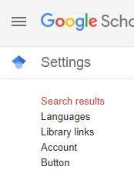
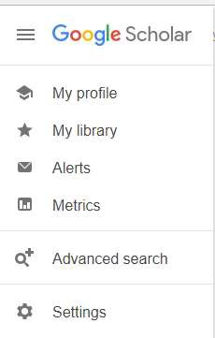
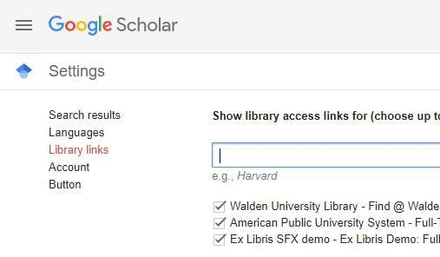
Not finding an article, but your university has access to it? You can search your University’s library by adding it to your profile! Start with the
icon on the homepage.
Adding a Library.

Slide 13

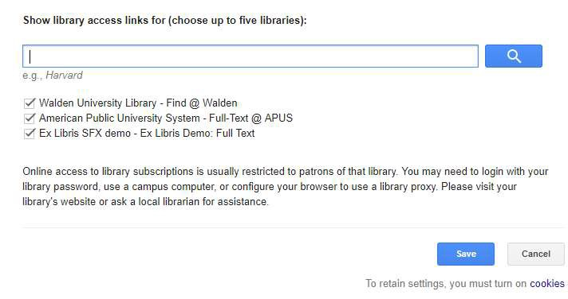
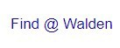
Search for your university.
Select the right one
Adding a Library.
l
Don’t forget to hit SAVE!
Look for this next time you search to access your library.

Slide 14




Google Scholar is not the end all be all of academic research.
Google’s search engine is an algorithm that displays the most popular results for the search criteria entered.
This means your first results are the most popular ones.
Your University database is tuned to your program area of study.
Google Scholar is a great starting point. But ALWAYS use your university’s library.
Linking through Google Scholar is not a substitute.
GoogleScholar vs.
University
Databses.

Slide 15


Content Covered
Introduction
What is GoogleScholar?
The Basics
Citation Management
Advanced Searching
Email Alerts
Adding a Library
GoogleScholar vs. University Databses
Bio

Slide 16





" --=
- . ' -
. ..
.,.....--r.,,... - ₋
--- - --··----
- -

Slide 17


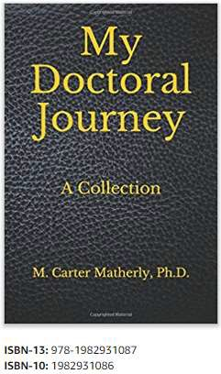





Carter Matherly, Ph.D.
Ph.D. Psychology
Masters of Science, Psychology
Masters of Arts, Intelligence Analysis – Terrorism
Carter.Matherly@gmail.com
Citation for Today’s Lecture:
Matherly, C. (2018) Google Scholar. Instructional Presentation.
Purchase My Doctoral Journey at Amazon to see
how each step of your research builds into your
final Dissertation. It is a guide book for academic
excellence!
I can also be found on all major Academic Social Media sites.

